Slide 1

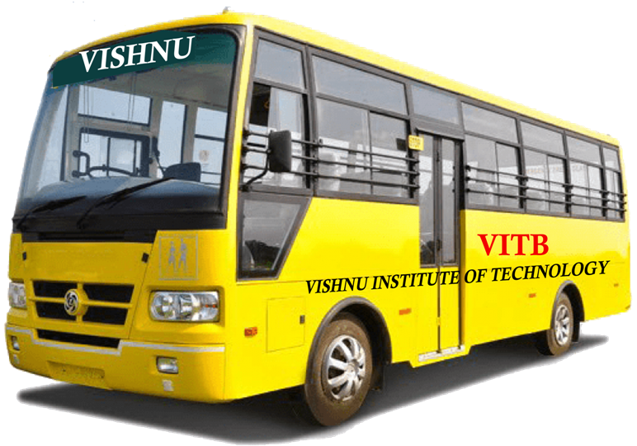
VBus
(Vishnu Bus Services)
Team :
N. Bhanu Durga Prasad (22PA1A12C8)
P. Sandeep Kalyan (23PA5A1214)
K. Siva Prasad (22PA1A1277)
M. Gnana Sagar (22PA1A12A1)
M. Venkata Saketh (22PA1A12B4)

Slide 2
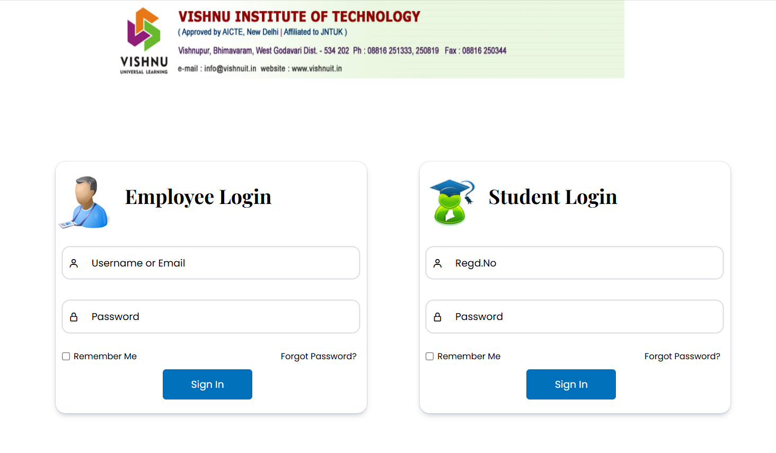
Login

Slide 3
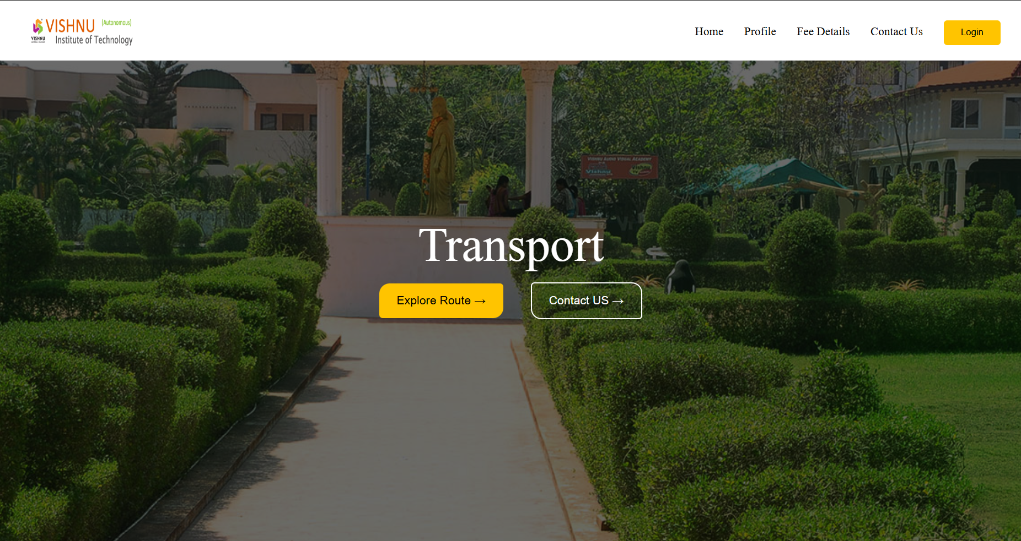
Home Page

Slide 4
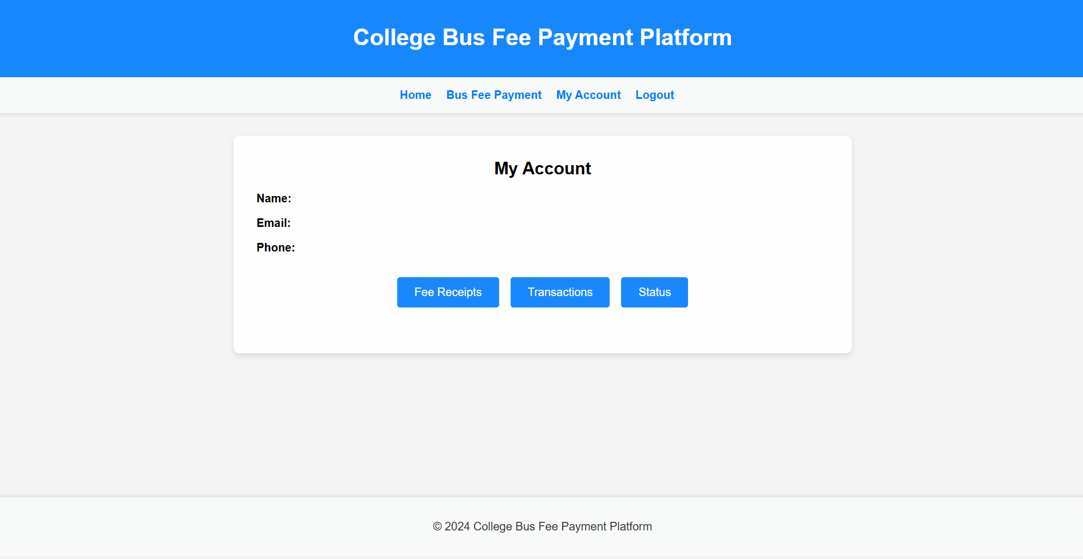
Profile Page

Slide 5
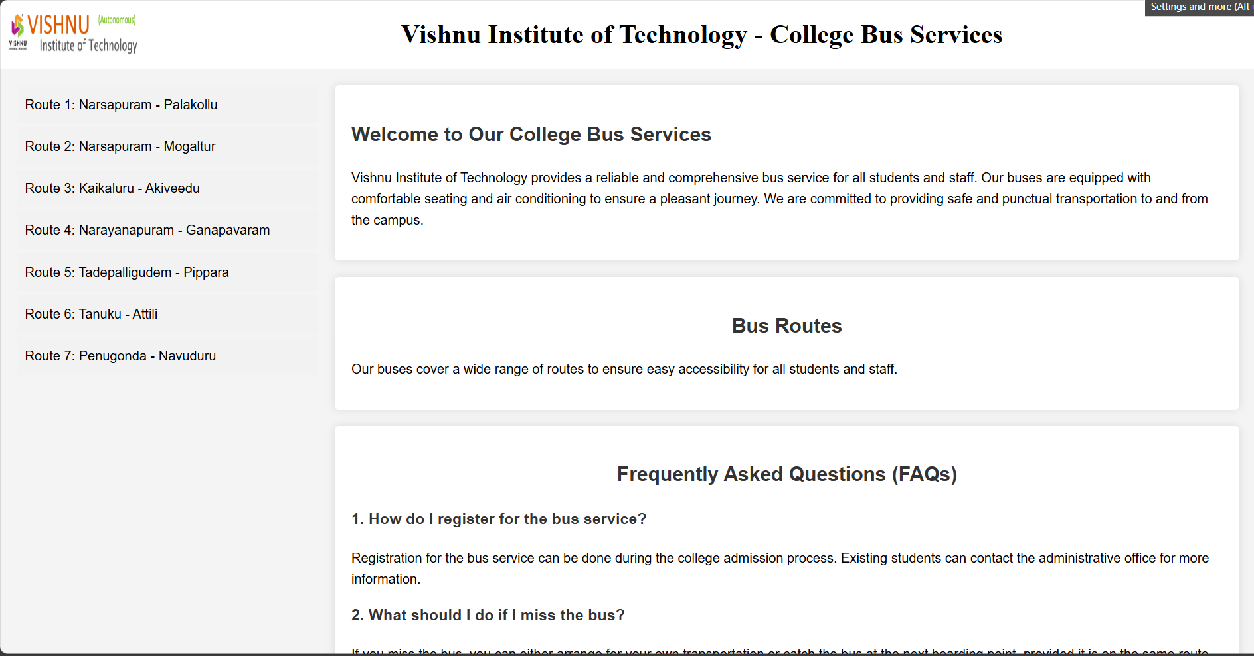
Bus Routes

Slide 6


